Slide 1
The Delivery Process

Slide 2
Making the Delivery
After the Order has been made

Slide 3
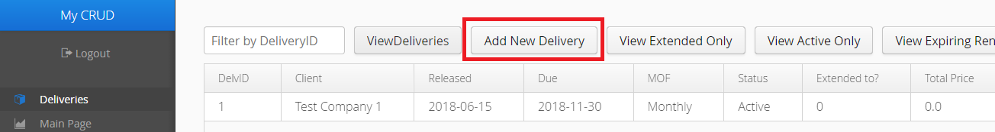
1) Making the Delivery
Click the Add New Delivery button

Slide 4
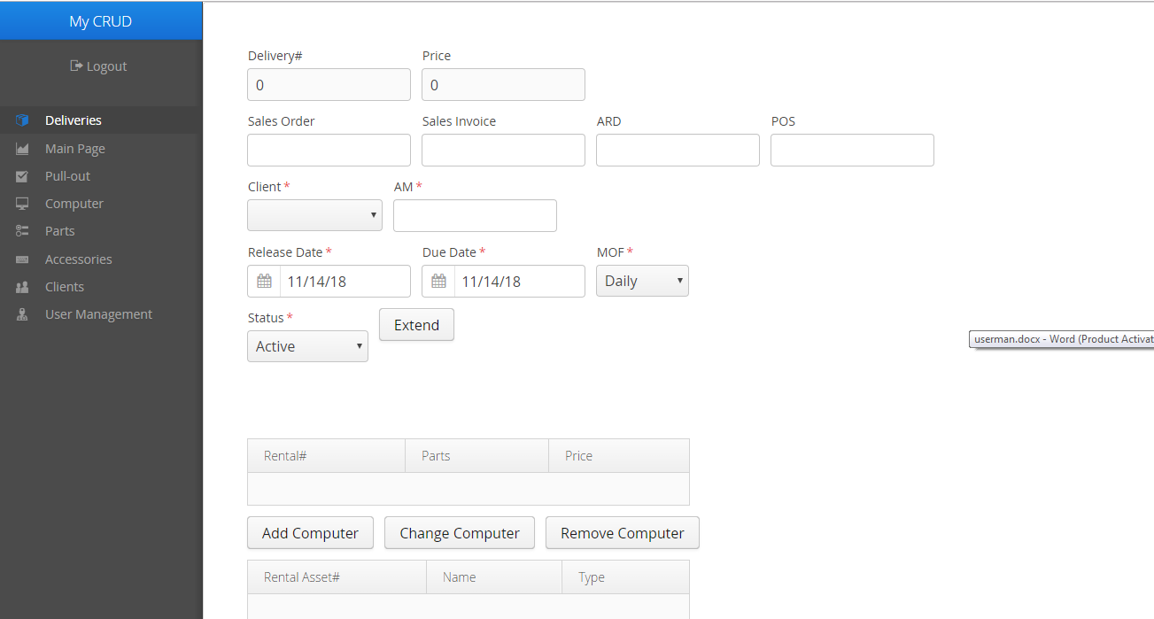
1) Making the Delivery
Fill in the necessary fields (red asterisks)

Slide 5
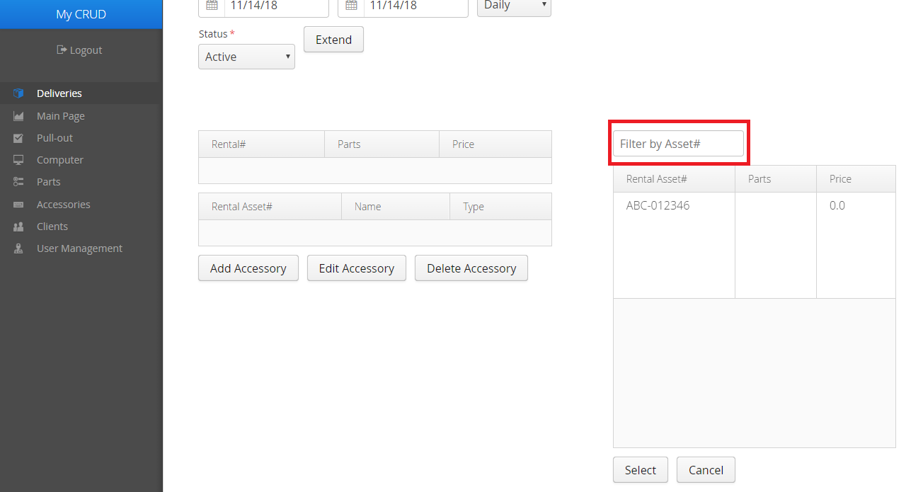
1) Making the Delivery
If applicable, Add Computers and Accessories
You can search for specific units with the search bar

Slide 6
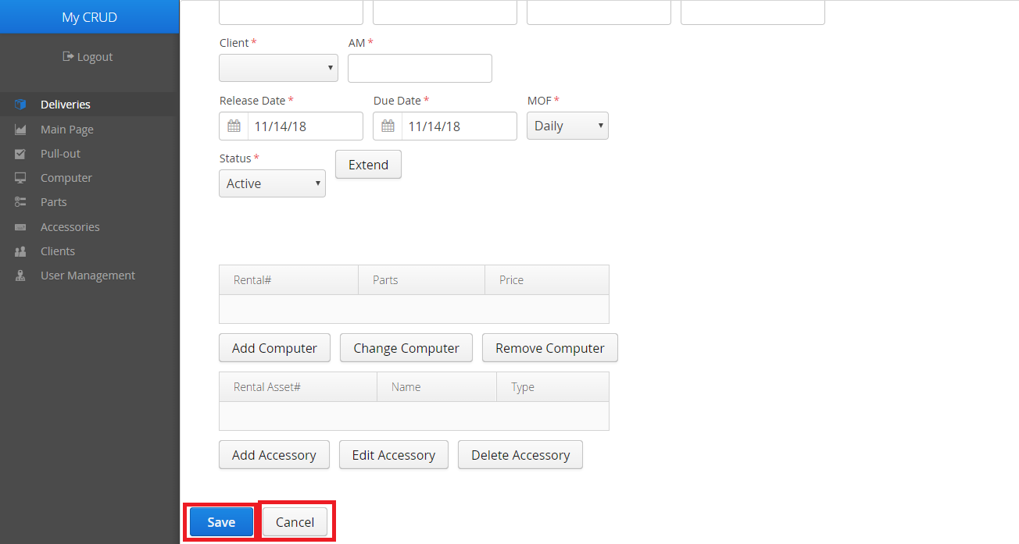
1) Making the Delivery
Click Save to finish
Cancel the creation with the Cancel button

Slide 7
Printing the Delivery Form
Before bringing the units to the Client

Slide 8
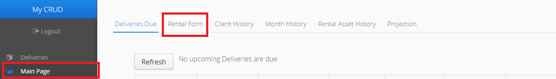
2) Printing the Delivery Form
Click the Main Page tab on the side menu
Click the Rental Form tab in the Main Page

Slide 9
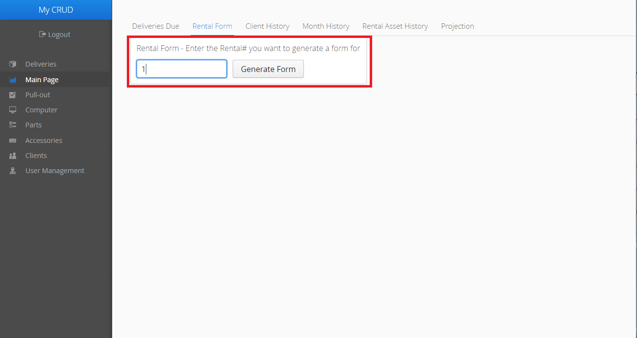
2) Printing the Delivery Form
Enter the Delivery# into the bar and click the button

Slide 10
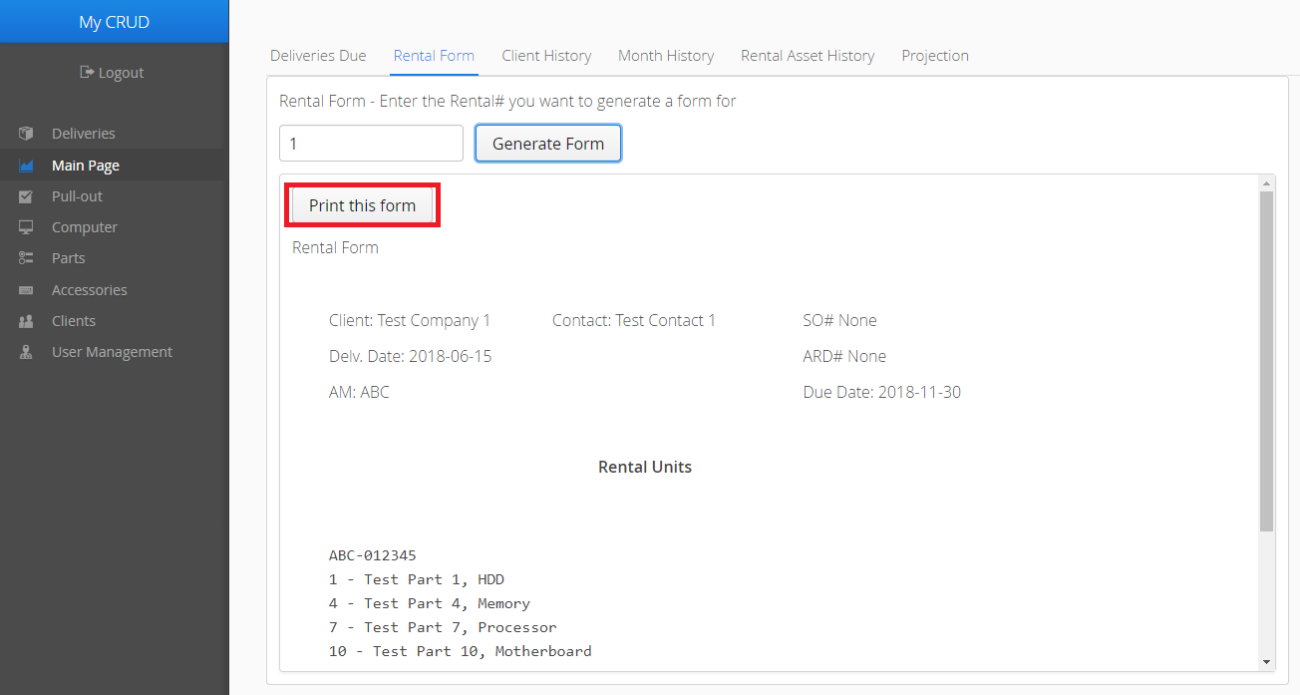
2) Printing the Delivery Form
A preview will appear on the webpage
Click Print this form to generate the form

Slide 11
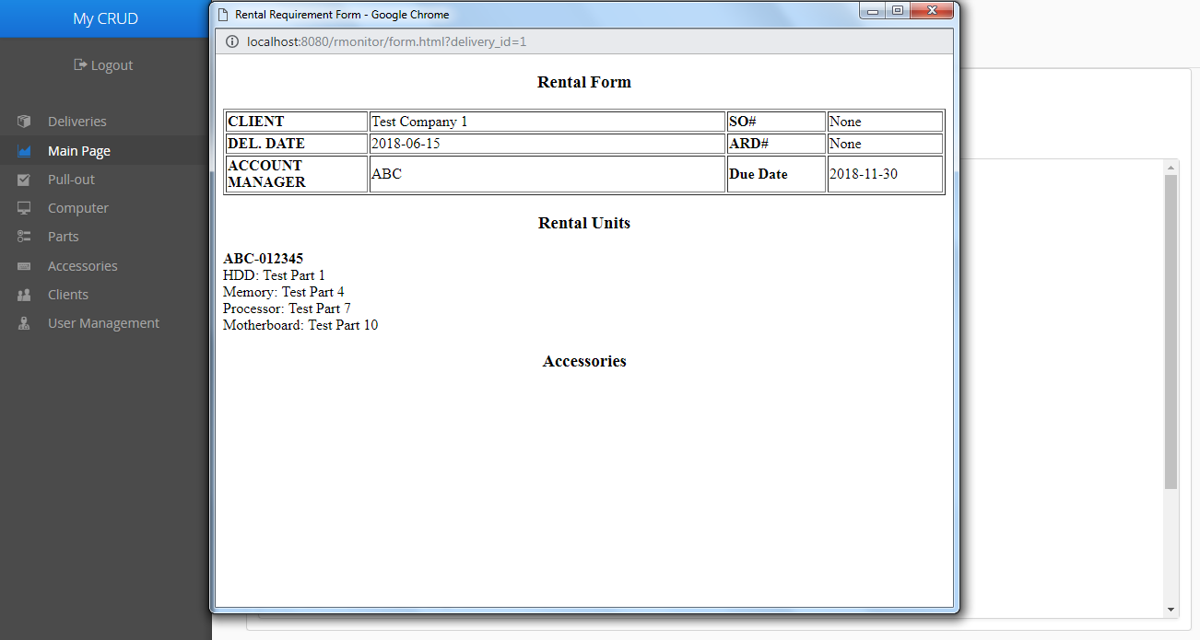
2) Printing the Delivery Form
Select the new window and press CTRL+P

Slide 12
Pulling-out the Delivery
On the due date

Slide 13
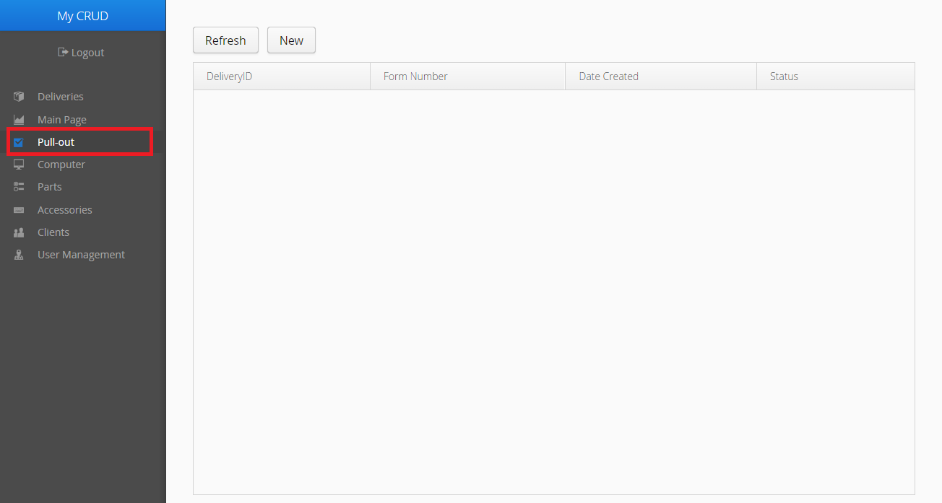
3) Pulling-out the Delivery
Click the Pull-out tab in the side menu

Slide 14
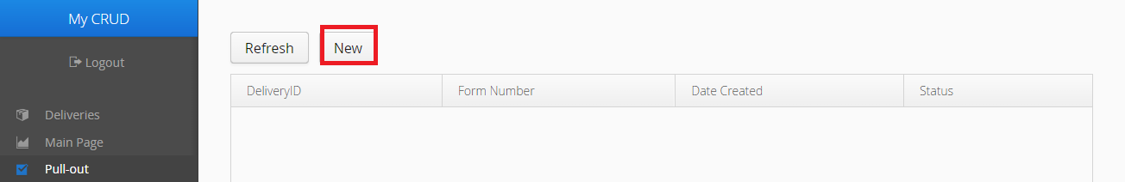
3) Pulling-out the Delivery
Make a new Pull-out form by clicking New

Slide 15
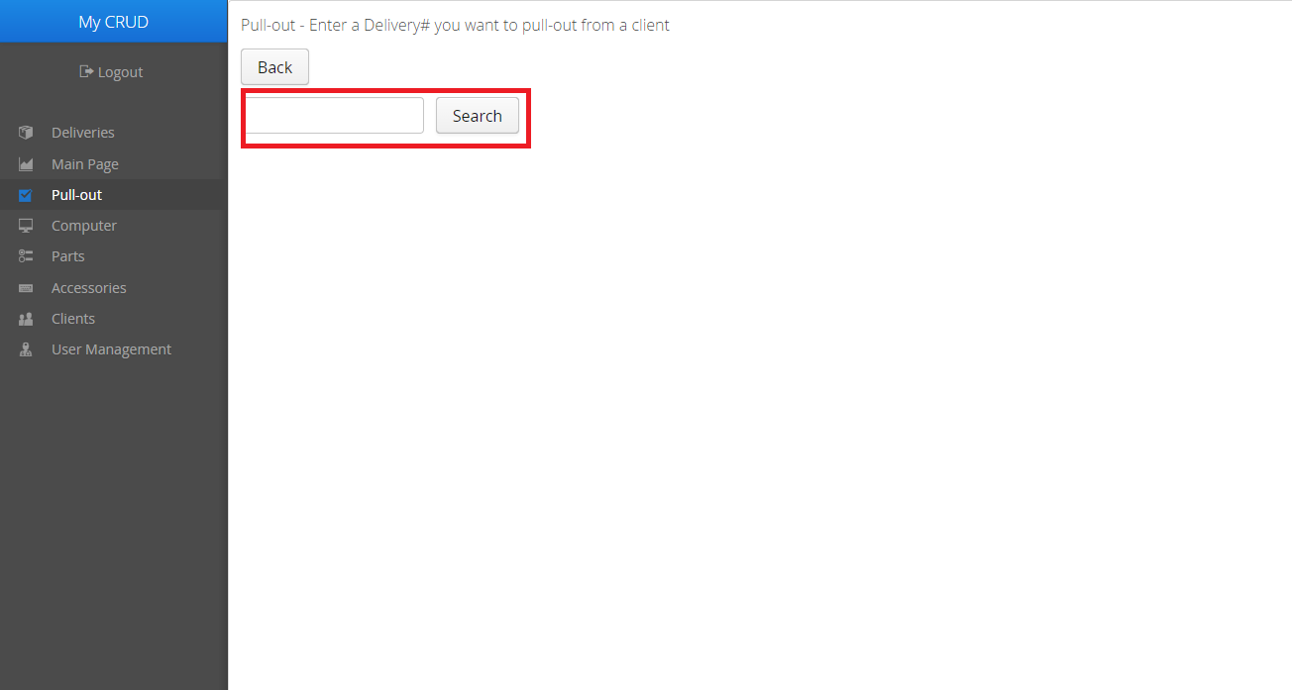
3) Pulling-out the Delivery
Enter the Delivery# in the first field and press Search

Slide 16
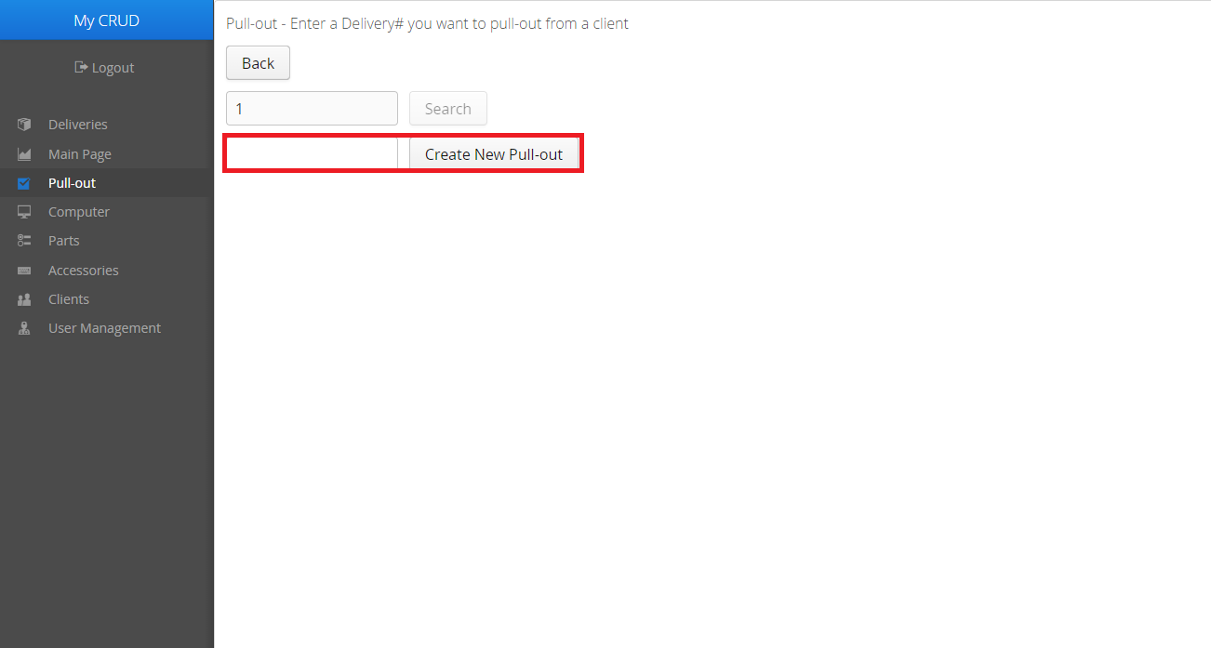
3) Pulling-out the Delivery
Enter a new Pull-out ID in the next field and click the button

Slide 17
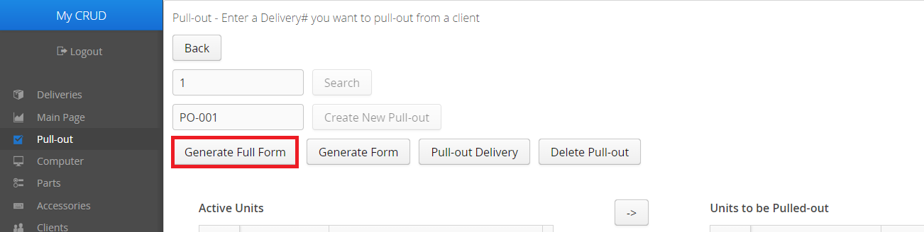
3) Pulling-out the Delivery
Click Generate Full Form for the initial Pull-out specs

Slide 18
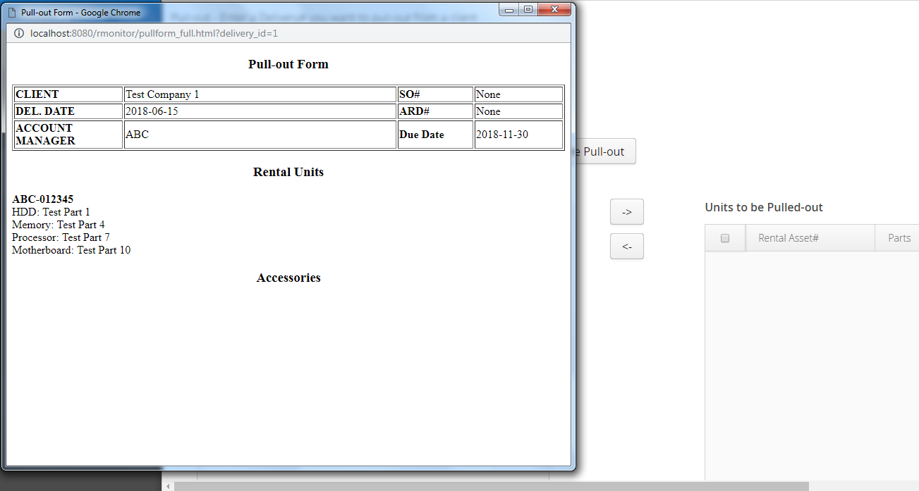
3) Pulling-out the Delivery
Click the new window, then press CTRL+P to print

Slide 19
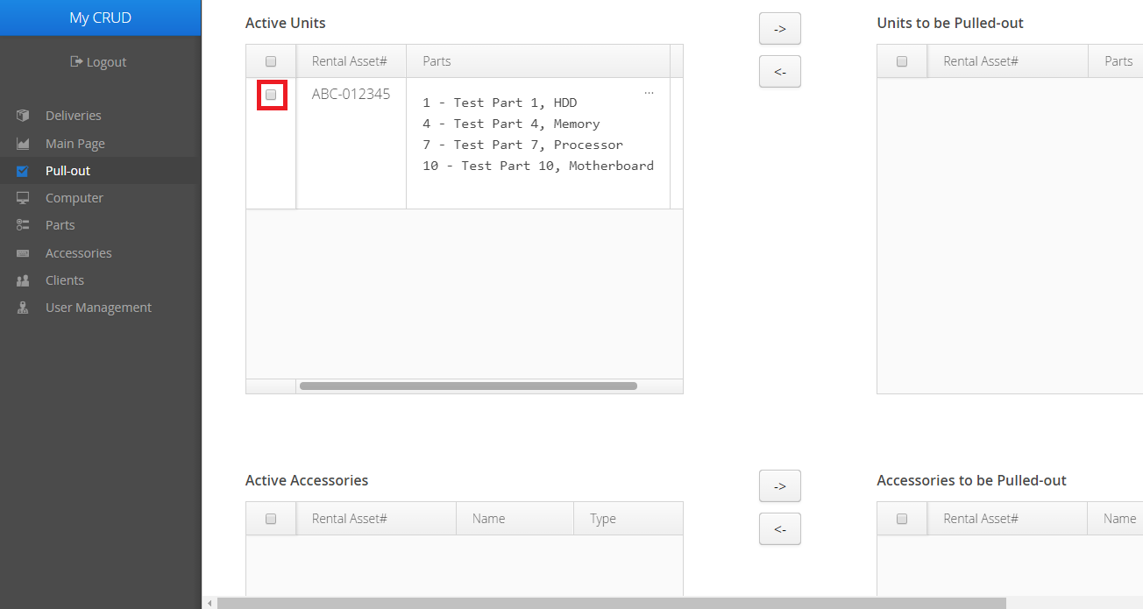
3) Pulling-out the Delivery
After returning from the Client, indicate which units will be returned by clicking the boxes beside the units

Slide 20
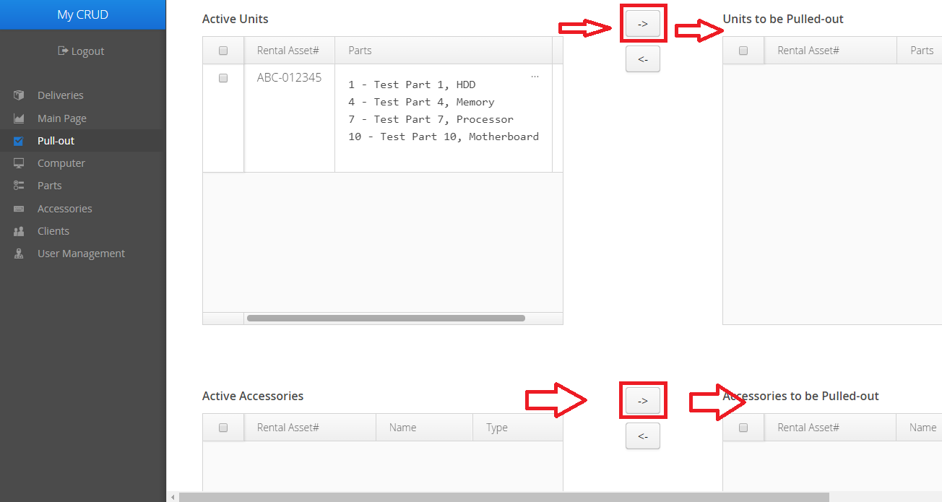
3) Pulling-out the Delivery
Click the left arrow button

Slide 21
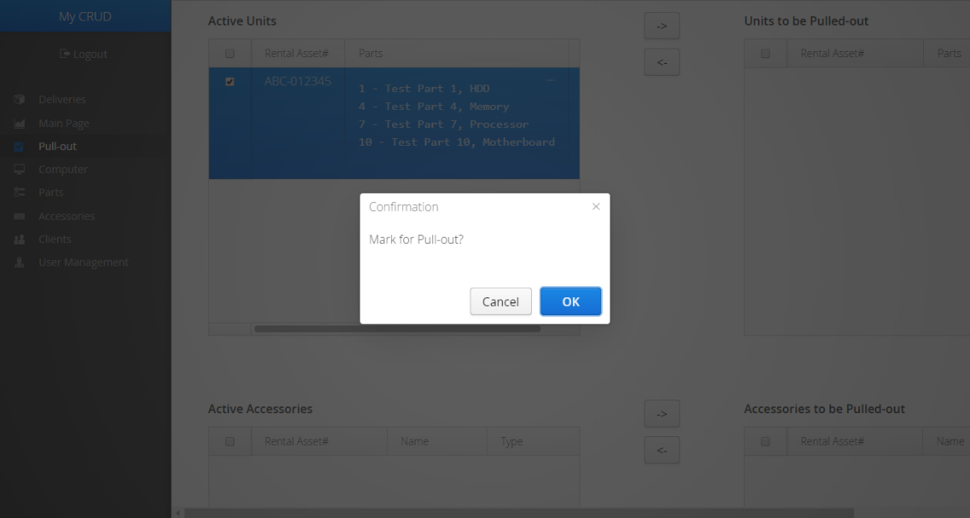
3) Pulling-out the Delivery
Click OK

Slide 22
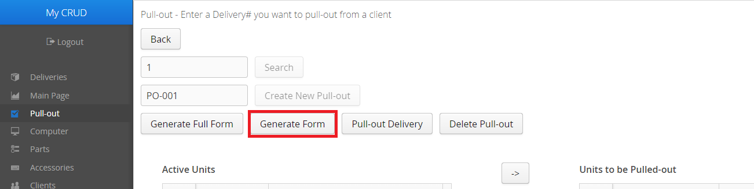
3) Pulling-out the Delivery
If you need to print a form for partial returning, click the Generate Form button at the top of the page
Make sure there are units to be pulled-out

Slide 23
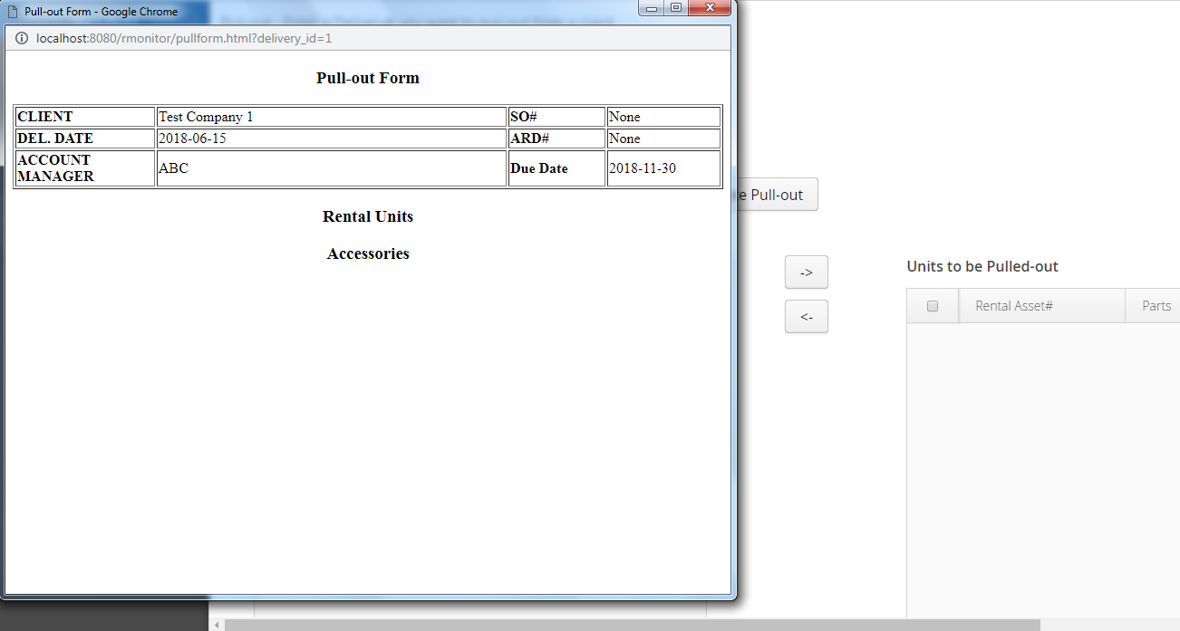
3) Pulling-out the Delivery
In the new window, press CTRL+P

Slide 24
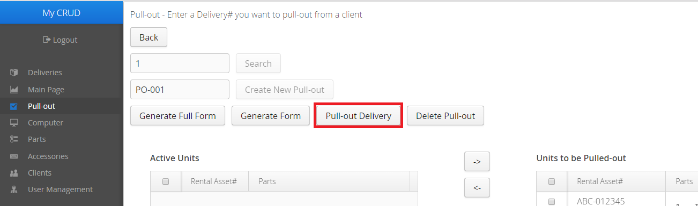
3) Pulling-out the Delivery
If the units to be returned have been returned to the inventory, click Pull-out Delivery

Slide 25
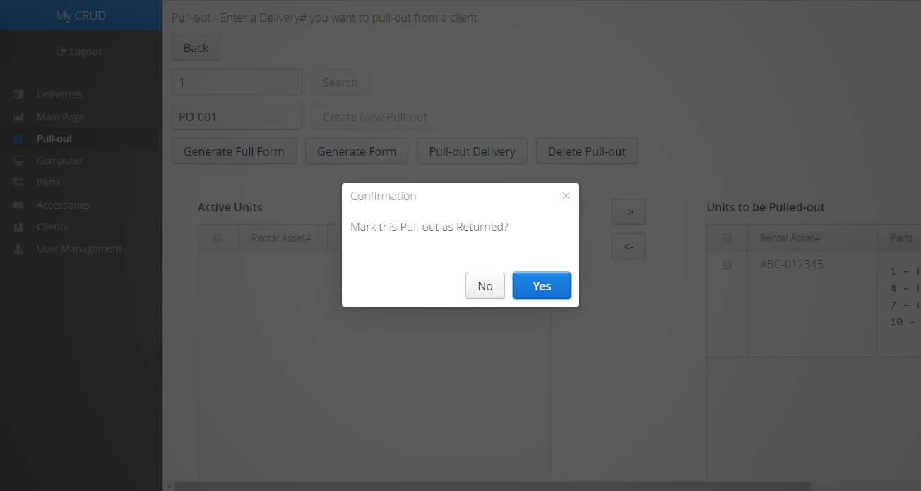
3) Pulling-out the Delivery
Press OK

Slide 26
3) Pulling-out the Delivery
Keep repeating the Pull-out process until all units have been returned

